Slide 1
TAMIL TEXT TO ENGLISH EMOTIONAL SPEECH WITH UNL FOR TRANSLATION
Siva M R
Archana B
Jayavasanth R
Guided by
Dr. Rajeswari Sridhar

Slide 2
ABSTRACT
Our project involves the translation of text from Tamil to English followed by the synthesis of speech from the converted English text using a Text-To-Speech engine.
This speech will be made humanised by analysing emotions from the translated text and adding appropriate prosodic content to the speech.

Slide 3
Translation and its need
Expressing the sense of words or text in another language is translation.
6500 spoken languages have been recognized till date. In order to lift the cross-cultural barrier caused by the absence of a universally spoken language (English is spoken by appr. 20% of the world population), translation is essential.

Slide 4
Scope and motivation
While English is the 2nd most spoken language in the world, Tamil is the 15th most spoken language.
Necessitates the need for a medium of translation between the two languages for those speakers who know only one of the two languages.
Official documents , school samacheer text books and even dialects in Tamil could be hereby voiced providing a great value.
Voice output would be beneficial to the blind.

Slide 5
Different Translation approaches
Rule-Based Machine Translation
Phrase Based Translation
Example Based Translation
Interlingua Based Approach

Slide 6
CHALLENGES – translation and adding emotions to existing tts
Example based Translation needs a very huge parallel data corpus.
BLEU Score for Tamil to English translation with a corpus of 75,000 words is 0.26
In word-by-word and Phrase based Translation the language specific grammar is not preserved.
Preserving the sentence meaning.
Word sense disambiguation.
Handling exceptions like phrases and idioms.
Adding emotions to voice at the signal level is difficult is because it is hard to predict the part of the word that needs to be modified.

Slide 7
WHAT IS UNL?
UNL – Universal Networking Language is a declarative formal language specifically designed to represent semantic data extracted from natural language texts by the UNDL
UNL can be used as an interlingua for conversion from source language to target language
Universal Words (UWs) are word expressing concepts that are linked with one another to form a UNL graph

Slide 8
Each universal word may have one or more properties denoted by Attributes . The attributes denote any one of tense ,mood , aspect , number etc., e.g. Present , past , indefinite , entry
Two UWs are linked by a relation. The are 46 relations in UNL including pos , aoj , agt etc.,
Two UWs joined by a relation may form a hyper node. It is also called as scope . A scope indicates that all elements of the scope have to be translated together to a single phrase.
UNL Format : <relation> ( <uw1> , <uw2> )
Hyper nodes : <scope-ID> ( <node1> , <node2> )

Slide 9
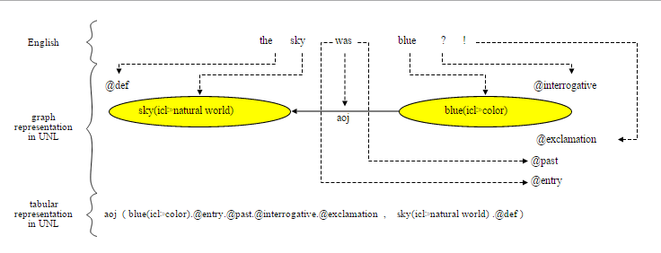
[UNL]
[W]
Blue (icl>color) @past, @entry, @interrogative, @exclamation
Sky (icl>natural world) @def
[/W]
01 aoj 02
[/UNL]
9

Slide 10
Literature survey
Paper Title and Authors | Concepts Discussed | Drawbacks
Statistical phrase-based translation P. Koehn, F. J. Och, and D. Marcu | Input is translated by grouping together words into phrases Extremely high performance can be achieved by heuristic learning and lexical weighting of phrase translations.
An Arabic to English example-based translation system K. Bar, Y. Choueka, and N. Dershowitz | Example based translation system tries to draw similarity between parts of text at the word or stem level. | An extensive bilingual or parallel corpus is required.
UNL Based Machine Translation System for Punjabi Language P. Kumar | A UNL based MT system for conversion from Punjabi to Hindi has achieved a BLEU score of 0:72

Slide 11
LITERATURE SURVEY
Paper Title and Authors | Concepts Discussed | Drawbacks
Tamil to UNL EnConverter (2002). T.Dhanabalan,K.Saravanan T.V.Geetha | Rule based approach Tags 46 UNL relations to one or more Tamil inflictions | Simple UNL graphs only constructed Requires domain analysis to remove ambiguity of relations
Morpho-Semantic Features for Rule-based Tamil Enconversion (2011). J Balaji , TV Geetha , Ranjani Parthasarathy, Madhan Karky | Rule based approach for forming UNL graphs Analyzing inflictions to relate Uws | No consideration about complex and compound Tamil Sentences Ambigious free word order sentences
Semantic Parsing of Tamil Sentences (2011). J Balaji , TV Geetha, Ranjani Parthasarathi | UNL Nested graph identification Uses mod, and, pos relations | No indications on punctuations Precision <60%

Slide 12
Paper Title and Authors | Concepts Discussed | Drawbacks
A hybrid approach to construction of Wordnet (2014). Jayavasanth R , Rajeswari Sridhar | Graph wordnet database with holonyms , meronyms , hypernyms and morph forms . POS equivalent translated words | No context based English equivalent analysis to distinguish words with same POS
A hybrid approach to Tamil Morphological generation (2014). Rajeswari Sridhar, Sugadev C, Manimurugesan P, Vignesh NT | Rule based approach to handle morphological analysis Uses a suffix table for inflections and generates inflected nouns and verbs | Rule based and so not flexible Does not handle all exceptions
Postagger and Chunker for Tamil Language (2009). Dhanalakshmi V., Anand kumar M., Soman K. P., Rajendran S. | Makes use of customized tagset to POS tag tamil sentences. Customised tagset reduces time and complexity increasing tagging accuracy

Slide 13
Paper Title and Authors | Concepts Discussed | Drawbacks
The production and recognition of emotions in speech: features and algorithms (2003). Pierre-Yves Oudeyer. | Emotions of Calmness , sadness , Anger , Comfort , Happiness have been incorporated. Variation in the age of the voice could be produced by overriding the sample rate. | Precision is less in this rule based approach
Emotions in the voice: Humanising a Robotic voice (2010). Tristan Bowles, Sandra Pauletto. | Uses copy synthesis or sound synthesis in which acoustic features are copied from real emotion portrayals. Modifying fundamental frequency and amplitude | The test subjects were able to recognize sadness positively but anger and happiness weren't distinguishable leading to wrong recognition of those emotions.
Adding an Emotions Filter to Malay Text-to-speech System (2006). Mumtaz Begum , Raja N. Ainon , Zuraidah M Don , & Gerry Knowles | Emotions filter was designed by manipulating pitch and duration using a rule based approach. For vowels, both pitch and duration is modified and for consonants, only the duration is modified. | The naturalness of the output could be better.

Slide 14
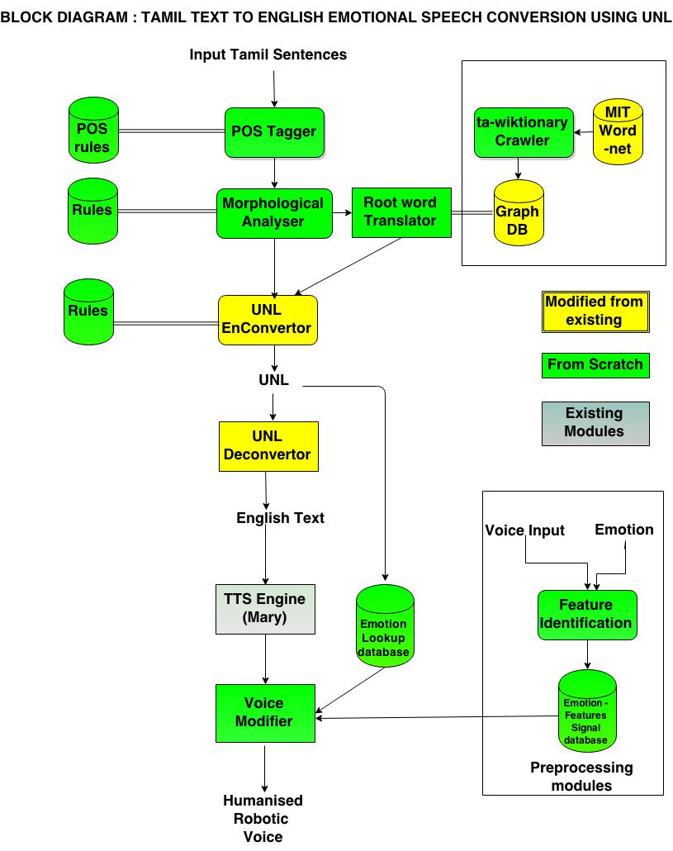

Slide 15
Contribution
We have custom designed a morphological analyser and POS Tagger to meet our requirements .The rules for morphological analyser are taken from tholkapiam.
Having UNL as interlingua makes translation easy from Tamil to any other language.
We have also developed an algorithm for the process of UNL to English Enconversion.
Various features of emotion are studied and manipulated to bring about variation in speech between the emotions.

Slide 16
Module description

Slide 17
Pos tagger
Tamil is partial free word order language
Hence the inflections are analysed to find the POS of a particular word
Inflections such as ‘ aye’ added to words , denote that they are objects in that sentence
Eg. Kaiyai pidathaan.
Words are scanned from right to left to handle vallinam-migum-idam
Uses a customized tagset tailored to fit the UNL relations
These tags are used in Morphological analysis and UNL graph construction

Slide 18
Algorithm – Two pass
Pass 1
Split the input sentence into words
Right to left scanning of words
Remove “க், ச், த், ப்” if any at the end
Identify pronouns and assign doer.
Check if the word ends with vinaimutru vigudhi, if so assign verb tag and send it to verb analyser
Check if the word ends with vetrumai, if so assign Noun tag and send it to noun analyser
In case of a named entity transliterate it to English. Eg: சென்னை – Chennai.
Handle adverbs and adjectives separately.
Pass II
Resolve ambiguity and partial word sense disambiguation.

Slide 19
Pseudo code
POSTag(String input){
words[] = input.replaceAll("\\s+", " ").split(" ");
matcher.find(“(க்|ச்|த்|ப்)”){ remove(); …}
matcher.find(pronoun){ POS=pronoun; doer=; …}
matcher.find(வினைமுற்று விகுதிகள்){ POS=verb; verb(words[i]); …}
matcher.find(பெயர்சொல் + வேற்றுமை){ POS=noun; noun(words[i]); …}
NamedEntityRecognition(words[i]){
POS=noun; noun(words[i]); …}
Determinants(words[i]){
POS=det; noun(words[i]); …}
Return segmentedword[];
}

Slide 20
Input and Output
Input:
அவன் புத்தகத்தை படிக்கிறான்
Output:
அவன் POS:pronoun POSid :2
புத்தகத்தை POS :object POSid :1
படிக்கிறான் POS :verb POSid :3

Slide 21
MORPHOLOGICAL ANALYSER
Tamil is a morphologically rich language.
A number of words can be formed from a root word by adding inflections.
The inflected words are analyzed to split in to root word and inflections
The root word is tagged as ‘Universal Word’ (UW) in the UNL representation
Features like tense, gender and plurality extracted from inflections are used in Deconversion

Slide 22
Algorithm
If noun POS tag
Identify the வேற்றுமை and word type (there are 16 word types and 7 வேற்றுமை types)
Identify the sub-word type and extract the root word handling திரிதல், விகாரம்.
Assign noun suffix and plurality based on the identified word, sub-word and வேற்றுமை types and the result from wordnet

Slide 23
Rules
Noun inflection types :
ஐ, ஆல், கு, இல், இன், அது, கண்,
Word types :
சேயை, கடையை,
கப்பலை, காலை
புத்த்கத்தை
கசப்பை
சாப்பாட்டை
காற்றை
புள்ளை,
காதை
மண்ணை
வேரை
சோர்வை
மானை
காசை
புத்தகங்களை, சொற்களை

Slide 24
Algorithm
If verb POS tag
Identify the இடைநிலை and விகுதி type (there are 16 word types and 8 இடைநிலை types)
Match the tense from இடைநிலை and doer from விகுதி.
Extract the root word handling திரிதல், விகாரம்.
Compare the root with wordnet and assign root word, tense, doer, plurality.
வருவான் – வா + வ் + ஆன்
வா → வரு என்றானது விகாரம்

Slide 25
Rules
இடைநிலைகள் :
த், ட், ற், இன் - Past tense
கிறு, கின்று - Present tense
ப், வ் - Future tense
விகுதிகள் :
(நடந்தேன்) ஏன்
(நடந்தோம்) ஓம்
(நடந்தாய்) ஆய்
(நடந்தீர்) ஈர்
(நடந்தீர்கள்) ஈர்கள்
(நடந்தான்) ஆன்
(நடந்தாள்) ஆள்
(நடந்தார்) ஆர்
(நடந்தார்கள்) ஆர்கள்
(நடந்தனர்) னர்
(நடந்தது) அது
(நடந்தன) அன

Slide 26
Pseudo code
Analyser(inflectedVerb){
Matchsuffix() {…}
GetTense() {…}
GetDoer() {…}
MatchSubWordType() {…}
ExtractRootWord() {…}
}
Analyser(inflectedNoun){
Matchsuffix() {…}
GetNounSuffix() {…}
MatchSubWordType() {…}
GetPlurality() {…}
ExtractRootWord() {…}
}

Slide 27
Input and Output
Input:
அவன்
Output:
rootword: அவன்
DoerSuffix :ஆன்
Input:
புத்தகத்தை
Output:
rootword: புத்தகம்
NounSuffix : ஐ

Slide 28
Input and Output
Input:
படிக்கிறான்
Output:
rootword: படி
TenseSuffix :கிறு
DoerSuffix :ஆன்

Slide 29
Word net Construction
Words from Madras Institute Technology (MIT) wordnet and an existing wordnet [3] are used for this.
The missing English terms in the MIT wordnet are crawled from tawiktionary.
A graph based structure is used to represent the wordnet where in the root node will represent the Tamil word and edges with values as noun , verb , adverb will point to nodes with respective English translation.
Neo4j is used to construct the wordnet graph for visualization.

Slide 30
Structure of the wordnet
noun
moon
நிலவு
hyponym
noun
planet
noun
மதி
respect
verb
கோள்
noun
wisdom
30

Slide 31
Structure of the wordnet
Nodes
Tamil word
English gloss
Relations
Verb → connecting a tamil word with its verb gloss
Noun → connecting a tamil word with its noun gloss
Adjective → connecting a tamil word with its adjective gloss
Adverb → connecting a tamil word with its adverb gloss
Hyponyms , Hypernyms , Holonyms and Homonyms

Slide 32
Universal Networking Language (UNL Enconversion and Sub-graph Identification
The root word of each segemented word is modified in to a Universal Word
The tense suffix of the Segmented word is analysed to choose the tense attributes
Certain classifier words are used to determine other attributes like
@def – antha , intha , athu , ithu
@indef – oru , ondru , aega
@continue – kolkindra
@interrogation - ? , vanth‘aaya’ , sendr’aaya;
@just – thatpothu , irpothu
@not - alla , il , illai

Slide 33
UNL Enconversion and Subgraph Identification
@exclamation - !
@polite – thayavu
@ability – iyalum , mudium
@sufficient - mattume
After identifying the possible attributes , two passes are used to find relations between Uws
The first pass is based on explicit verb ending
eg . Avan puthagath’ai’ padithaan
Tamil nouns are modified by the seven – ‘ai’ , ‘aal’ , ‘ku’ , ‘in’ , ‘athu’ , ‘kan’

Slide 34
UNL Enconversion and Subgraph Identification
Each of these suffixes denote one or more relationships eg.
Avan kadai’ku’ senraan
Here ‘ku’ denotes ‘gol’ – final place relation
Avan puthagathai padithaan
Here ‘ai’ makes the previous subject avan the agent – agt
The second pass is for hidden suffix verbs
Avan puthagam padithaan
Here there is no noun suffixes shown explicitly . In these cases the trigram approach is used to resolve the relation type.

Slide 35
UNL Enconversion and Subgraph Identification
Then the HyperNodes in the sentence are identified based on explicit prefixes.
Eg. Naan << puthi’ya’ puthagam >> ondrai vaanginen
The UNL graph will now consist of UWs with tamil root words
Based on the POS these Uws correspond to , the english equivalent of these words are fetched from the wordnet.
Eg . Aadu , noun -> goat
Aadu , verb -> dance

Slide 36
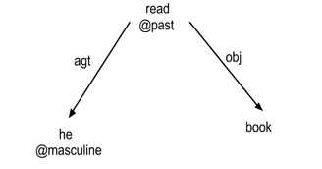
UNL Enconversion and Subgraph Identification
Input
Tamil Sentence
eg. புத்தகத்தை படித்தான் அவன்
Output:
UNL expression

Slide 37
Pseudo code
UW ← Universal Word
UNL ← Universal Networking Language
HN ← Hyper Node
Rel ← UNL Relations
Enconvert ( Seg[] ){
For each S_{i} in Seg[i]
UW[i] = root [S_{i}]
attributes[i] = Suffix_Analysis ( S_{i} ) + Word_Analysis( S_{i})
For each UW[i],S[i] in UW,Seg
rel [i , i+1, k] = Suffix_analysis ( S_{i} , S_{i + 1} ) + Domain_analysis ( root [ S_{i} ])
HN[j] = Suffix_analysis (S_{i} , S_{i + 1})
K++; j++;
UNL = UW + HN + Rel
}

Slide 38
UNL DeConversion
Conversion from the UNL structural language to the final target language, (i.e, English) is called deconversion.
Deconversion is aided with the help of Simple NLG
A new algorithm is developed for deconversion.
This algorithm traverses the UNL Graph in DFS manner

Slide 39
UNL DeConversion
Every relation in UNL can be attributed to one POS in English language. For example, an agt relation denotes agent and can be attributed to the Subject.
Considering an SVOA pattern the subject should come first and so the the node corresponding to the Subject should be traversed first.
Consider tmi and tmf relations - if they both exist in the sentence they would contribute to the phrase “ from <tmi> till <tmf> ”. Hence, tmi should be traversed before tmf.Same way ordering between all the relations can be defined.

Slide 40
UNL DeConversion
Input : UNL
Output : English Sentence
Eg. He read a book.

Slide 41
Pseudo code
Deconvert ( UNL ){
For each h_{i} in UNL.hyperNodes
Noun,Verb,Object,Adverb<- Relation_Analysis(h_{i})
Clause_{i} = NLG_clause(Noun,Verb,Object,Adverb)
S.English = SimpleNLG (Clause _{i to j})
}

Slide 42
MaryTTS- A TTS synthesis platform
MaryTTS is an open-source, multilingual Text-to-Speech Synthesis platform written in Java
Speech is synthesised in 4 stages as:
Preprocessing-tokenising
NLP- Calculation of phone symbols and intonation
Calculation of acoustic parameters
Synthesiser-creates sound file

Slide 43
EMOTION-FEATURES DATABASE CONSTRUCTION
Input
Voice samples are taken and studied to identify their characteristics.
Feature extraction- using MATLAB, AUDACITY & PRAAT
Various features of speech like fundamental frequency, intensity are tabulated for each voice input.
The values of each of these parameters for each emotion is identified.

Slide 44
Corpus for emotion database
The voice samples are obtained from 3 female speakers who have similar speech characteristics as that of Marytts’ voice.
Sentences are recorded in a variety of emotions such as angry, happy, sad and neutral.

Slide 45
Corpus processing
The sentences are read into Audacity, an audio analysis software in order to distinguish between the word boundaries clearly and to split them into audio files corresponding to each word.
If excess noise has been recorded, then using the noise removal feature of Audacity, the audio sample can be made relatively noise free.

Slide 46
Algorithm to determine fundamental frequency F0 in MATLAB
INPUT: sample voice signal showing a certain emotion such as happiness/sadness/anger.
F0 estimation using the complex cepstrum
Load speech waveform along with sampling frequency into MATLAB workspace.
Perform Fourier transform of windowed signal
Cepstrum is determined as the DFT of log spectrum

Slide 47
Algorithm to determine fundamental frequency F0 in MATLAB
Fundamental frequency is determined from cepstrum as
Pseudo code:
F0 = estimate(){
Y=fft(x.*hamming(length(x)))
C=fft(log(abs(Y)+eps)) [c,fx] = max(abs(C(ms1:ms20)))
F0 = fs/(ms1+fx-1) //is fundamental } frequency

Slide 48
In time domain using autocorrelation:
This method is used to verify the frequencies obtained from cepstrum.
Pseudo code:
[(samples,sampling rate)] = wavread(audio file)
millisecond2 = sampling rate / 500
millisecond20 = sampling rate /50
rvalue = XCorrelation(samples, millisecond20)
(rmaxvalue ,tx) = max(rvalue(millisecond2: millisecond20))
Fundamental frequency = fs/(millisecond2+tx-1)

Slide 49
DETERMINATION OF DURATION OF EACH WORD – USING AUDACITY
This is measured using Audacity that has a millisecond calibration so that the exact duration of every word can be estimated.

Slide 50
INTENSITY ESTIMATION-USING PRAAT
Generally, words said with different emotions differ in the intensity with which they are spoken.
For eg, when a person speaks with anger, there is a greater intensity in the voice than when compared to a person who speaks with sadness.
So, this measurement is done with the help of PRAAT tool, that can accurately measure with what intensity the word was spoken. It is measured in decibels.

Slide 51
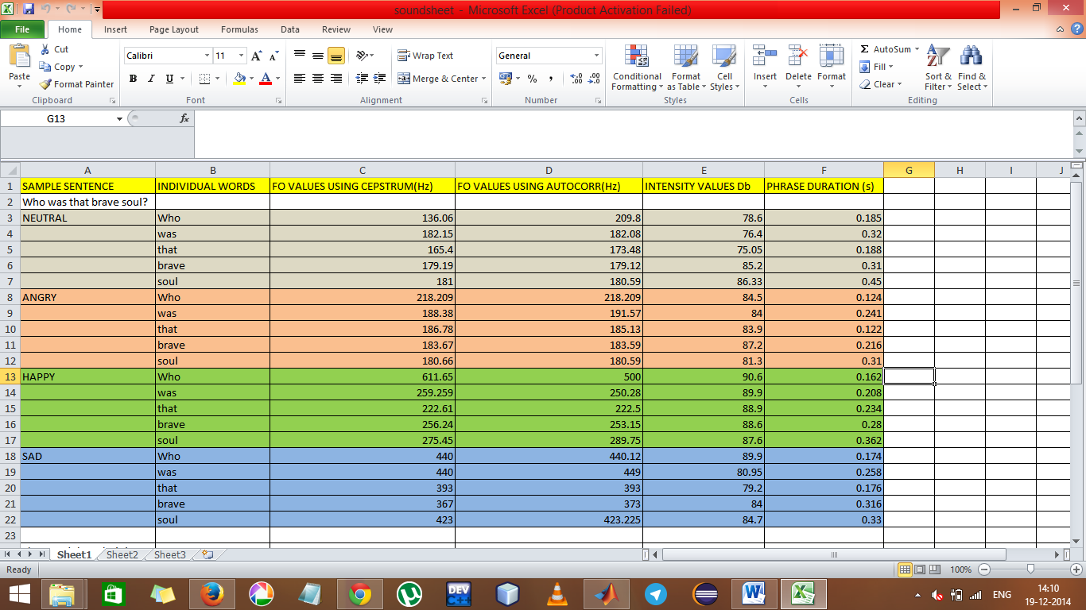

Slide 52
Emotion Identification
The emotion present in the sentence is calculated by using the output of the UNL which is annotated with the tone of the sentence.
Various degrees of emotion can be identified based on the strength of the words that are used in the sentence.
After this has been estimated, it is mapped onto one of the emotions that have been handled in the emotion-features database.

Slide 53
Voice Modification
The output of the text to speech system is modified to add the prosody.
The emotion features database is consulted and the corresponding values of various parameters (like fundamental frequency, intensity, duration etc) are calculated.
Then the robotic voice is modified based on the values of these parameters to produce the humanised voice.

Slide 54
Flow from input to output

Slide 55
Tamil
sentence
POS Tagger
Morphological
Analyser
UNL
En Converter
Rules
Rules
Rules+ POS DB
UNL Graph
English Text
UNL
DeConverter
TTS Engine
Emotion
Look up
Identified
emotion
Robotic voice
Voice Modifier
Emotion
features
MODIFIED VOICE

Slide 56
After POS-Tagger
கன்னியாகுமரியில் இருந்து சென்னை வரை நான் நடந்தேன்
கன்னியாகுமரியில்- Noun
இருந்து – Echam
சென்னை – Noun
வரை – Misc
நான் – Subject
நடந்தேன் – Verb
back

Slide 57
After Analyser
கன்னியாகுமரியில்-
Root Word –கன்னியாகுமரி
Noun Suffix – இல்
POS - 1 (Object)
Noun Suffix Id - 2
இருந்து
Root Word –இருந்து
POS – 7 (etcham)
சென்னை
Root Word – சென்னை
POS – 1
வரை
Root word – வரை
POS - 7
நான்
Root Word – நான்
POS – 2 (pronoun)
நடந்தேன்
Root Word –நட
Tense Suffix id – 4 ( த்)
POS - 1 (Object)
Verb Suffix Id - 9 (ஏன்) back

Slide 58
In UNL EnConverter
[கன்னியாகுமரி இருந்து சென்னை வரை நான் நட]
[சென்னை வரை நான் நட]
frm
[கன்னியாகுமரி]
[ நான் நட]
frm to
[கன்னியாகுமரி] [சென்னை]

Slide 59
In UNL EnConverter
[ நட]
frm to agt
[கன்னியாகுமரி] [சென்னை] [நான்]
[ walk ]@past
frm to agt
[kanniyaakumari] [sennai] [ I ] @singular back

Slide 60
In UNL DeConverter
Reorder: [ walk]
agt from to
[ I ] [kanniyakumari] [sennai]
Adding [ walk ]@past
Scope dummy
agt unl from to
[ I ] [sennai]
[ scope - dummy] [ kanniyakumari ]

Slide 61
DeConversion by DFS
I walk@past [frm] kanyakumari [to] chennai
I walk@past [frm] kanyakumari [to] chennai
I walked [frm] kanyakumari [to] chennai i walked [frm] kanyakumari [to] chennai
I walked from kanyakumari to chennai. Back

Slide 62
Voice Modification
Identify – Sad , Angry or Happy emotions from the UNL
Sad – Duration and intensity modification
Happy – F0 modification
Angry – Duration,F0, intensity and amplitude modification

Slide 63

SAD BEFORE AND AFTER
ANGRY BEFORE AND AFTER

Slide 64
EVALUATION OF THE SYSTEM

Slide 65
Data set
The input sentences are taken from fourth, fifth and sixth standard Samacheer book.
The reference translations are also obtained from the English version of the same book.
About hundred sentences in each of the types - simple, complex and compound are tested and the results are measured.

Slide 66
evaluation
For evaluating translation four measures namely, BLEU, NIST, METEOR and Fluency and Adequacy are employed.
Since Tamil does not have accurate sentence types, the evaluation is categorized based on the type of sentence (simple, compound or complex) of the reference text.

Slide 67
Bleu score
BLEU stands for Bilingual Evaluation Understudy.
It is a n-gram co-occurrence based MT evaluation system that verified how close the MT translated text is to , to a human translated reference. N-gram precision in BLEU is computed as follows:
Pn= ∑_{Cϵ{Candidates}}∑_{n−gramϵC}Count_{clip}(n−gram) ------------------------------------------------------------
_{Cϵ{Candidates}}∑_{n−gramϵC}Count(n−gram)
Where Count_{clip}(n − gram) is the maximum number of n-grams co-occurring in a candidate translation

Slide 68
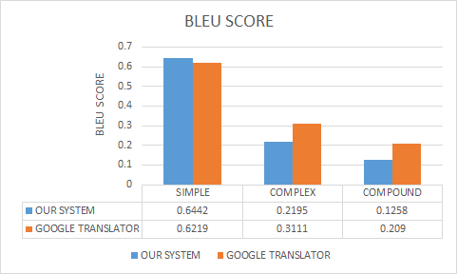
BLEU score comparison WITH GOOGLE TRANSLATOR

Slide 69
METEOR EVALUATION
METEOR stands for Metric for Evaluation of Translation with Explicit ORdering.
It is based on the harmonic mean of unigram precision and recall , with recall weighted higher than precision.
It also has several features that are not found in other metrics, such as stemming and synonymy matching, along with the standard exact word matching.
Score is
M = F_{mean}(1− p)

Slide 70
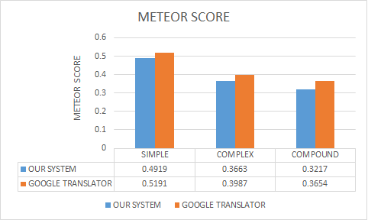
meteor score comparison with google TRANSLATOR

Slide 71
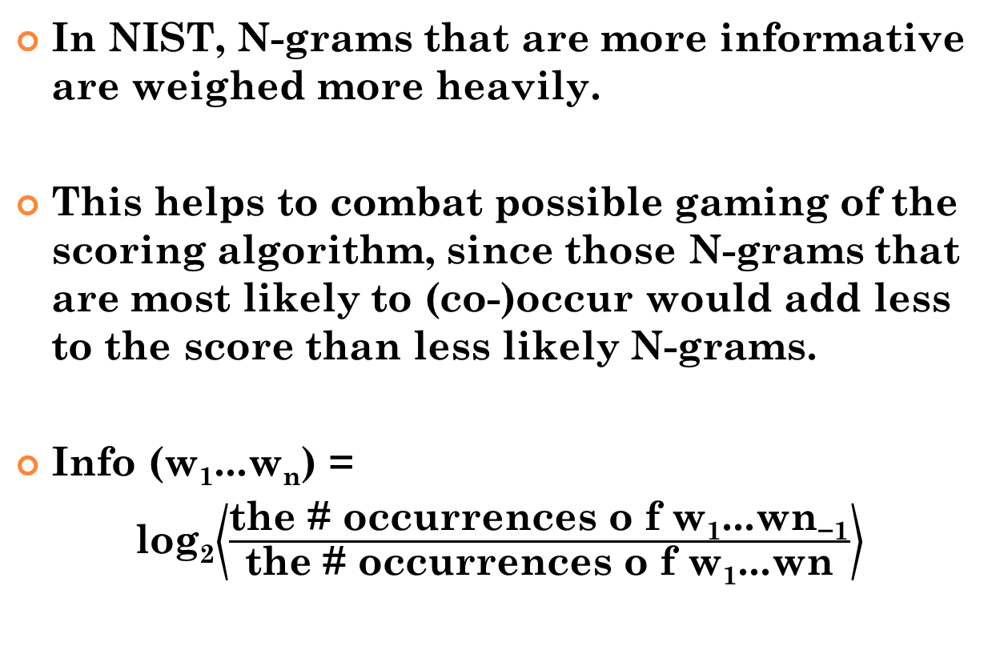
NIST evaluation
In NIST, N-grams that are more informative are weighed more heavily.
This helps to combat possible gaming of the scoring algorithm, since those N-grams that are most likely to (co-)occur would add less to the score than less likely N-grams.
Info (w₁...w_{n}) =
log₂$\left\langle \frac{\text{the}\text{ \# }\text{occurrences} \text{o} \text{f} \text{w}\text{1}\text{...}\text{wn}\text{−}\text{1}}{\text{the}\text{ \# }\text{occurrences} \text{o} \text{f} \text{w}\text{1}\text{...}\text{wn}}\right\rangle$

Slide 72
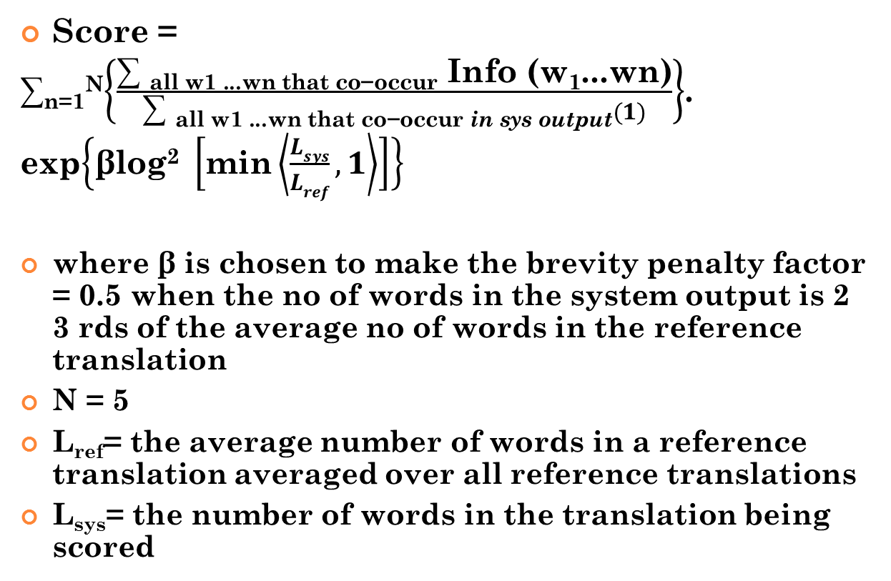
NIST EVALUATION
Score =
∑_{n=1}^{N}$\left\{\frac{\text{∑ }\text{all} \text{w}\text{1 }\text{...}\text{wn} \text{that} \text{co}\text{−}\text{occur} \text{Info}\text{ (}\text{w}\text{1}\text{...}\text{wn}\text{)}}{\text{∑ }\text{all} \text{w}\text{1 }\text{...}\text{wn} \text{that} \text{co}\text{−}\text{occur} \text{in} \text{sys} \text{output}(1)}\right\}$.
exp$\left\{\text{β}\text{log}\text{2} \left[\text{min}\left\langle \frac{Lsys}{Lref},1\right\rangle \right]\right\}$
where β is chosen to make the brevity penalty factor = 0.5 when the no of words in the system output is 2 3 rds of the average no of words in the reference translation
N = 5
L_{ref}= the average number of words in a reference translation averaged over all reference translations
L_{sys}= the number of words in the translation being scored

Slide 73
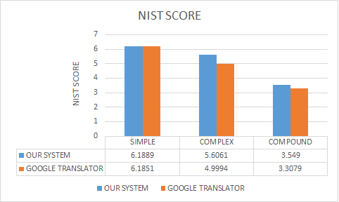
NIST score comparison with GOOGLE TRANSLATOR

Slide 74
Fluency
Fluency is a measure of the grammatical correctness of the sentence.
Fluency score description
Score | Description
4 | perfectly correct sentence
3 | Minor tense/Noun-verb flaws , Understandable
2 | Major grammatical flaws , Understandable with effort
1 | 1 Sentence makes no sense

Slide 75
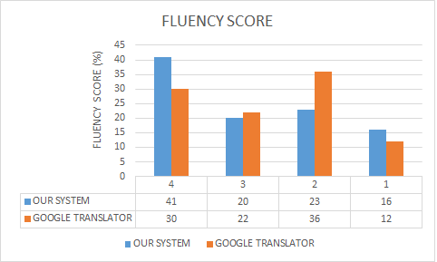
fluency score comparison with google TRANSLATOR

Slide 76
adequacy
Adequacy determines the degree of information conveyed by the translated text.
Score | Description
4 | Full meaning conveyed
3 | Most of the meaning conveyed
2 | Noun and/or Tense information conveyed
1 | No meaning at all

Slide 77
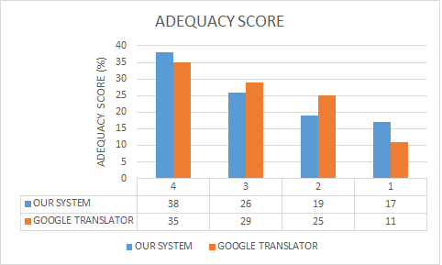
adequacy score comparison with google TRANSLATOR

Slide 78
Evaluation of emotional speech
A survey was conducted to determine how well emotion was expressed in the final prosodically enhanced output sentences.
Six recordings comprising of outputs expressing angry, happy and sad emotions were played and the corresponded responses were recorded

Slide 79
Survey Results on Identifying the Emotion present in Modified Voice
Emotion | Percentage of total responses that accurately identified the emotion from modified voice
Anger | 65%
Happiness | 57%
Sadness | 81%

Slide 80
Scores for Emotion present in the Modified Voice
Emotion | Average score for the identified emotion given by responder on a scale of 1-5
Anger | 3.6
Happiness | 3.2
Sadness | 4.1

Slide 81
CONCLUSION
This system translates Tamil text to English text with UNL as interlingua and then voices the English text out with emotions.
The results of evaluation showed that UNL is indeed efficient in translation.
We have successfully added three emotions (sadness, happiness and anger) to the machine voice.

Slide 82
CRITICISM
Most of the erroneous translations are attributed to the faults in POS Tagger.
POS Tags were assumed on words, on which no POS Tag could not be specified based on rules due to the non-availability of domain information and those words being void of any inflections.
This becomes much more difficult because of WSD - word sense disambiguation where the same word has multiple meanings based on its POS tag.

Slide 83
CRITICISM Contd.
The number of POS Tags was also limited to noun, verb, pronoun, adverb and adjective.
Exceptions also existed in Morphological analyser especially when there were named entities included as a part of the sentence.
Out of the 47 UNL relations 35 were handled for Enconversion.

Slide 84
Future Work
By increasing the word count in our Wordnet and also adding more domain information to the existing words, better accuracy could be achieved.
Also, implementing Named Entity Recognition would aid in better POS Tagging.

Slide 85
REFERENCES
[1] G. G. Chowdhury, “Natural language processing,” Annual review of information science and technology, vol. 37, no. 1, pp. 51–89, 2003.
[2] K. W. Church and R. L. Mercer, “Introduction to the special issue on computational linguistics using large corpora,” Computational linguistics, vol. 19, no. 1, pp. 1–24, 1993.
[3] J. Lehrberger and L. Bourbeau, Machine Translation: Linguistic characteristics of MT systems and general methodology of evaluation, vol. 15. John Benjamins Publishing, 1988.
[4] L. Dugast, J. Senellart, and P. Koehn, “Statistical post-editing on systran’s rule-based translation system,” in Proceedings of the Second Workshop on Statistical Machine Translation, pp. 220–223, 2007.

Slide 86
REFERENCES
[5] P. Koehn, F. J. Och, and D. Marcu, “Statistical phrase-based translation,” in Proceedings of the 2003 Conference of the North American Chapter of the Association for Computational Linguistics on Human Language Technology-Volume 1, pp. 48–54, 2003.
[6] V. Kumar, R. Sridhar, S. Narayanan, and S. Bangalore, “Enriching spoken language translation with dialog acts,” in Proceedings of the 46th Annual Meeting of the Association for Computational Linguistics on Human Language Technologies: Short Papers, pp. 225– 228, 2008.
[7] D. Chiang, “A hierarchical phrase-based model for statistical machine translation,” in Proceedings of the 43rd Annual Meeting on Association for Computational Linguistics, pp. 263–270, 2005.

Slide 87
REFERENCES
[8] A. Ramanathan, J. Hegde, R. M. Shah, P. Bhattacharyya, and M. Sasikumar, “Simple syntactic and morphological processing can help english-hindi statistical machine translation.,” in IJCNLP, pp. 513–520, 2008.
[9] K. Bar, Y. Choueka, and N. Dershowitz, An Arabic to English example-based translation system. PhD thesis, 2007.
[10] Y. Lepage and E. Denoual, “Purest ever example-based machine translation: Detailed presentation and assessment,” Machine Translation, vol. 19, no. 3-4, pp. 251–282, 2005.
[11] J. G. Carbonell, S. Klein, D. Miller, M. Steinbaum, T. Grassiany, and J. Frey, “Context-based machine translation,” pp. 19–28, 2006.

Slide 88
REFERENCES
[12] H. Uchida, M. Zhu, and T. Della Senta, Universal Networking Language. 2005.
[13] P. Kumar, UNL Based Machine Translation System for Punjabi Language. PhD thesis, Tharapur University, Patiala, 2012.
[14] D. Schwarz, “Data-driven concatenative sound synthesis,” in Proceedings of the COST G-6 Conference on Digital Audio Effects (DAFX-00), Verona, Italy,2009.
[15] R. Carlson, T. Sigvardson, and A. Sjölander, “Data-driven formant synthesis,” KTH, Stockholm, Sweden, Progress Report, vol. 44, pp. 121–124, 2002.
[16] J. Stark, B. Lindblom, and J. Sundberg, “Apex an articulatory synthesis model for experimental and computational studies of speech production,” TMH-QPSR, vol. 2, pp. 45–48, 1996.

Slide 89
REFERENCES
[17] K. Tokuda, T. Yoshimura, T. Masuko, T. Kobayashi, and T. Kitamura, “Speech parameter generation algorithms for hmm-based speech synthesis,” in IEEE International Conference on Acoustics, Speech, and Signal Processing, vol. 3, pp. 1315–1318, 2000.
[18] R. J. McAulay and T. F. Quatieri Jr, “Computationally efficient sine wave synthesis for acoustic waveform processing,” June 26 1990. US Patent 4,937,873.
[19] A. W. Black and K. A. Lenzo, “Flite: a small fast run-time synthesis engine,” in 4th ISCA Tutorial and Research Workshop (ITRW) on Speech Synthesis, 2001.
[20] S. Sangeetha and S. Jothilakshmi, “Syllable based text to speech synthesis system using auto associative neural network prosody prediction,” International Journal of Speech Technology, vol. 17, no. 2, pp. 91–98, 2014.

Slide 90
REFERENCES
[21] T. Bowles and S. Pauletto, “Emotions in the voice: humanising a robotic voice,” in Proceedings of the 7th Sound and Music Computing Conference, Barcelona, Spain, 2010.
[22] I. Manuel and Tolkappiyar, Literary theories in Tamil: with special reference to Tolkappiyam, vol. 8. Pondicherry Institute of Linguistics and Culture, 1997.
[23] R. Jayavasanth and R. Sridhar, “Tamil wordnet based on a hybdrid approach,” 13th International Tamil Internet Conference, pp. 120– 124, 2014.
[24] G. Doddington, “Automatic evaluation of machine translation quality using n-gram co-occurrence statistics,” in Proceedings of the second international conference on Human Language Technology Research, pp. 138–145, 2002.

